Slide 1


MALLA REDDY INSTITUTE OF TECHNOLOGY (RJ)
Maisamaguda, Dhulapally (Post Via Hakimpet), Secunderabad -10.
A MINI PROJECT
PRESENTATION
ON
“HEART DISEASE IDENTIFICATION METHOD USING MACHINE LEARNING IN E-HEALTHCARE”
UNDER THE GUIDANCE BY
Mrs.S.Rajeshwari
Made By
V.Harika - 21RJ1A05Q9
P.Nikesh - 22RJ5A0519
J.Sathish - 22RJ5A0512
U.Manideep - 21RJ1A05Q5

Slide 2
HEART DISEASE IDENTIFICATION METHOD USING MACHINE LEARNING IN E-HEALTHCARE

Slide 3
Contents
Abstract
Introduction
Existing system
Disadvantages
Proposed system
Advantages
System Architecture
System Requirements
UML Diagrams
Output Screens
Conclusion
Future Enhancements

Slide 4
Abstract
Heart disease is a leading cause of mortality worldwide, emphasizing the need for accurate and efficient diagnostic methods.
This study proposes a novel heart disease identification method using machine learning (ML) classification in
E-Healthcare.
Our approach combines data preprocessing and ML algorithm selection to develop an accurate and reliable classification model.
Using a comprehensive patient record dataset, we evaluate our model's performance and demonstrate its potential for improving heart disease diagnosis in e-healthcare settings.

Slide 5
Introduction
A stroke occurs due to poor blood flow to the brain which results in cell death. Two main types of stroke are ischemic stroke and hemorrhagic stroke. Ischemic stroke occurs due to lack of blood flow and hemorrhagic stroke occurs due to bleeding.
There are several stroke risk factors that regulate different types of stroke. Predictive algorithms help to understand the relation between these risk factors to types of strokes. The machine learning algorithm can improve patients’ health through early detection and treatment.

Slide 6
Existing system
Manual diagnosis for heart disease involves doctors checking your symptoms, medical history, and risk factors like high blood pressure, and cholesterol. They use tools like ECGs, stress tests, and blood tests to look for signs of heart problems.
While this method works in many cases, it has some drawbacks. It relies on general tests that don’t always account for individual differences or early warning signs. Doctors’ judgments can sometimes vary, and these methods might miss complicated patterns that lead to heart disease. Overall, manual diagnosis is helpful but not as accurate or personalized as newer, technology-driven methods.

Slide 7
Disadvantages
Inaccurate Diagnosis: Manual diagnosis can be prone to errors and misinterpretations.
Delayed Detection: Delayed diagnosis can lead to complications and increased severity of heart disease.
High Costs: Traditional diagnostic methods can be expensive and time-consuming.

Slide 8
Proposed system
This system is proposed as a machine learning-based diagnosis method for the identification of Heart Disease in this research work.
Machine learning predictive models including Artificial Neural Networks (ANN), Naïve Bayes, J48, Random Forest, and K Nearest Neighbour (KNN) to classify the stroke disease.

Slide 9
Advantages
Early Detection: Develop a machine learning system to identify heart disease at an early stage, improving patient outcomes.
Risk Prediction: Analyze patient data to provide accurate predictions of heart disease risk levels.
Support for Healthcare Providers: Assist clinicians with actionable insights and evidence-based recommendations.
Preventive Care: Enable timely interventions and lifestyle adjustments to reduce heart disease prevalence.
Integration and Security: Ensure seamless integration with healthcare platforms while maintaining data privacy and compliance.

Slide 10
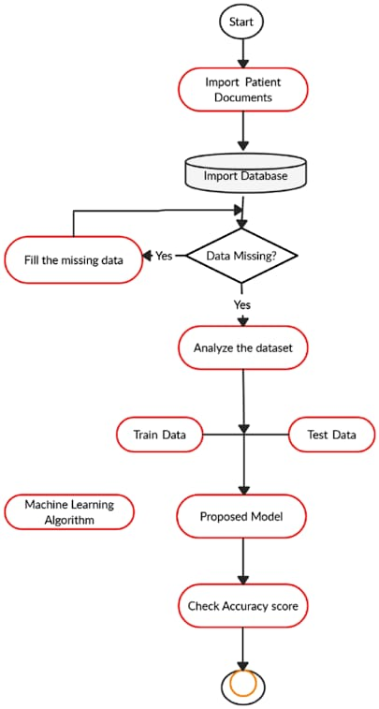
System Architecture

Slide 11
System Requirements
System : Minimum i3
Hard Disk : 40 GB
Ram : 4 GB
Operating System : Windows 8
Coding Language : Python 3.7

Slide 12
Modules
Upload Stroke Dataset:
Dataset Preprocessing & Features Selection:
Train Naive Bayes Algorithm
Train J48 Algorithm:
Train KNN Algorithm:
Train Random Forest Algorithm:
Train ANN Algorithm
Comparison Graph:

Slide 13
UML Diagrams

Slide 14
Class Diagrams

Slide 15
Sequence Diagram

Slide 16
Collaboration Diagram

Slide 17
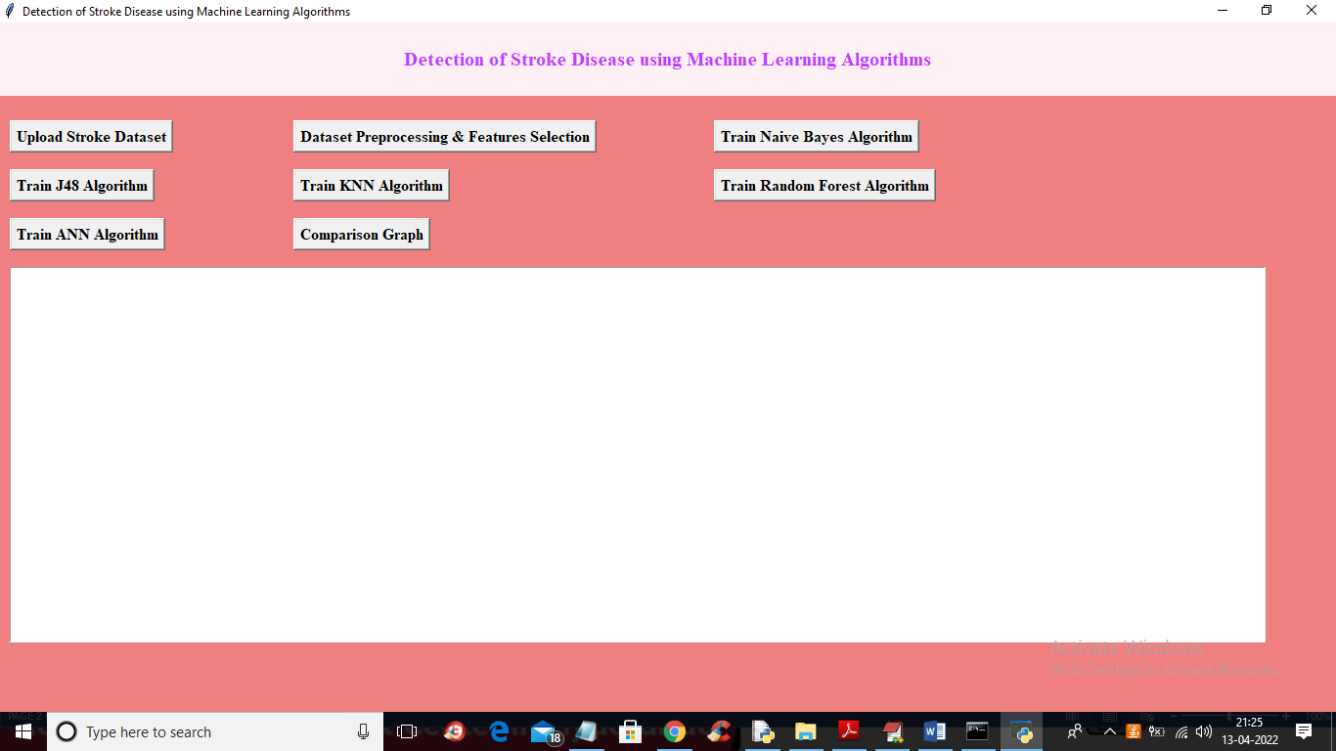
Output Screens

Slide 18
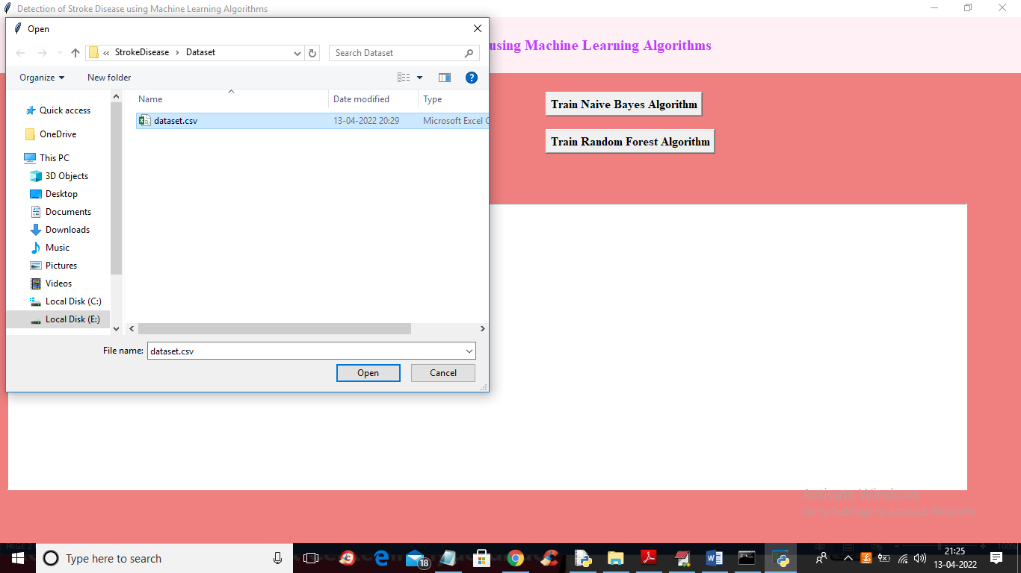
Upload Dataset

Slide 19
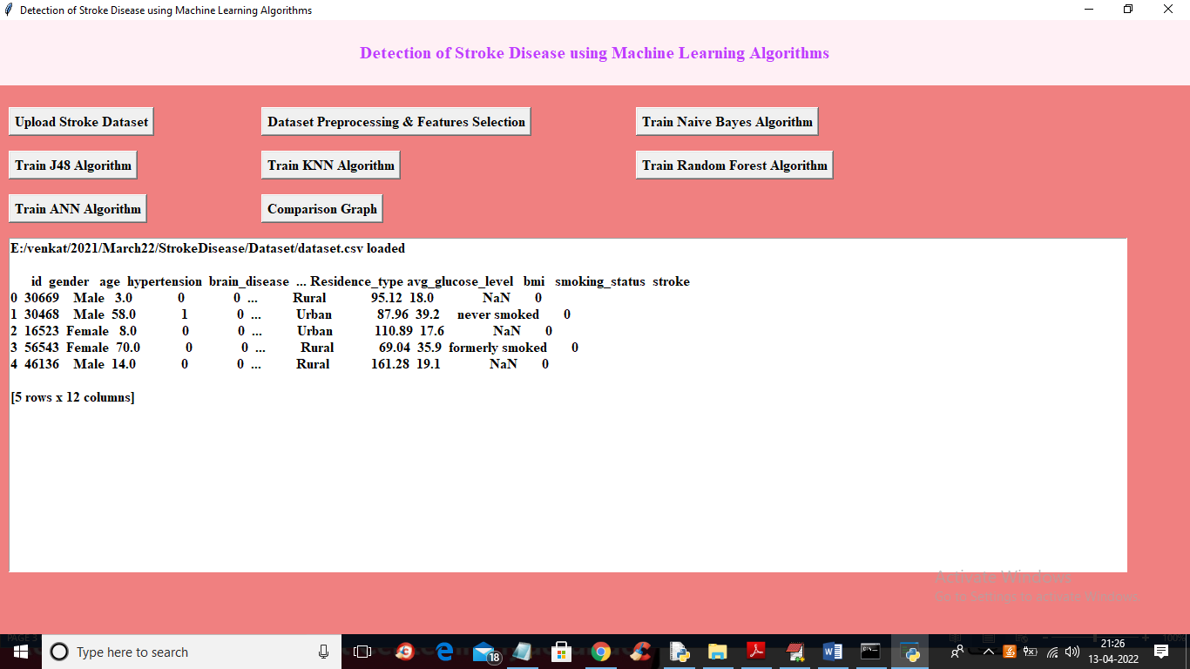
Data Preprocessing

Slide 20
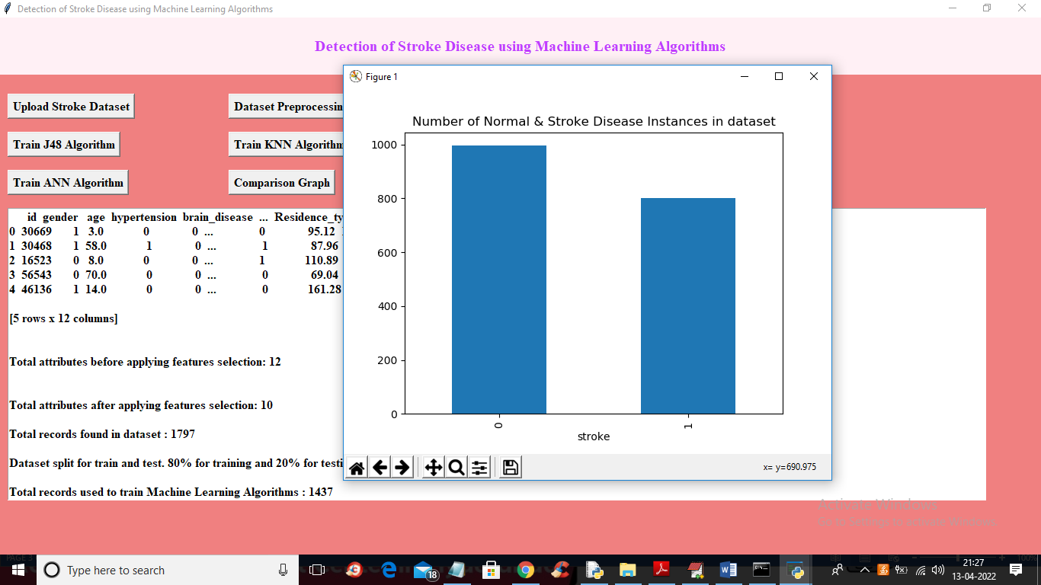
Graph Representation

Slide 21
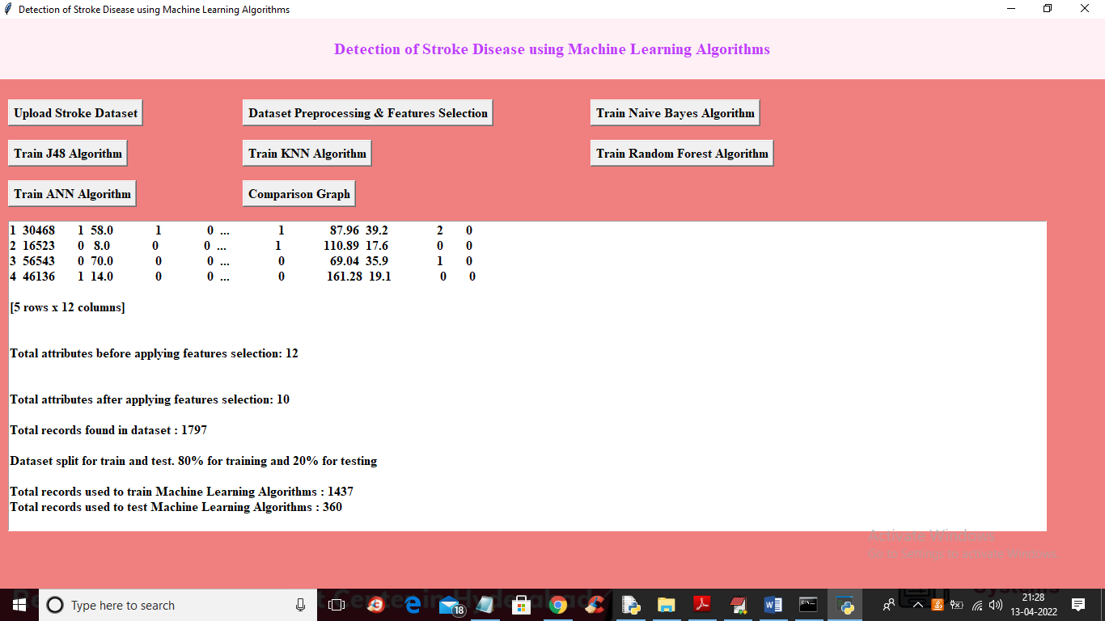
Dividing Data Set

Slide 22
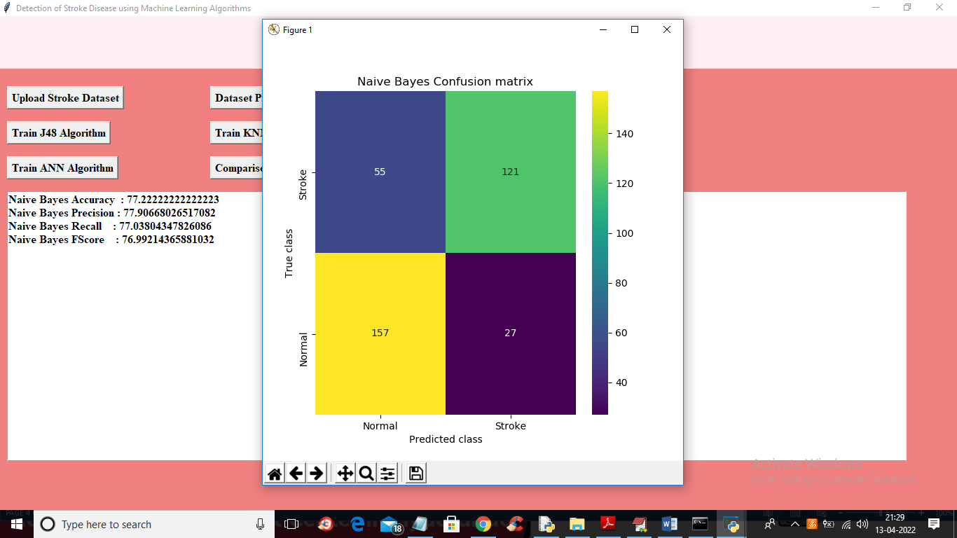
Naïve Bayes Algorithm

Slide 23
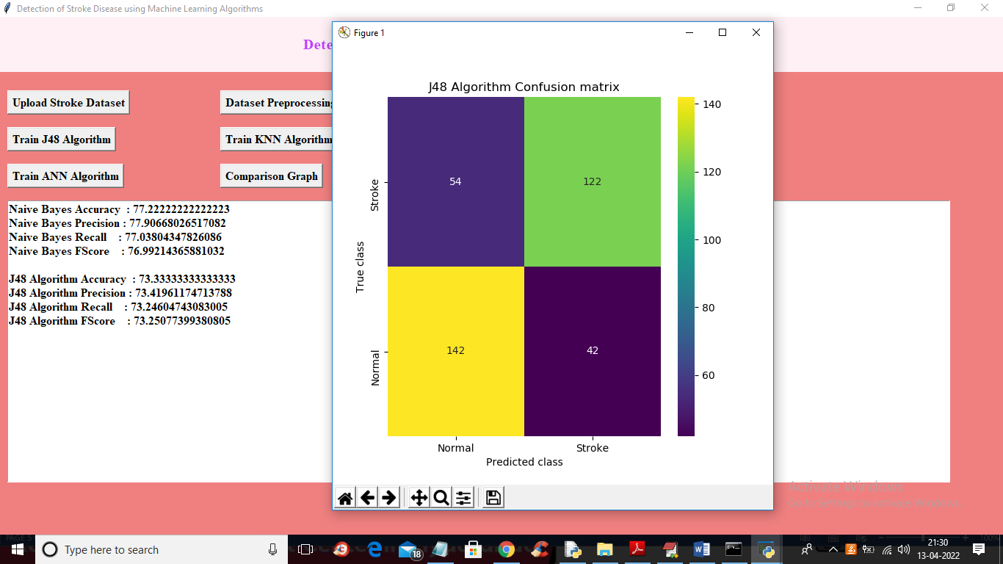
J48 Algorithm

Slide 24
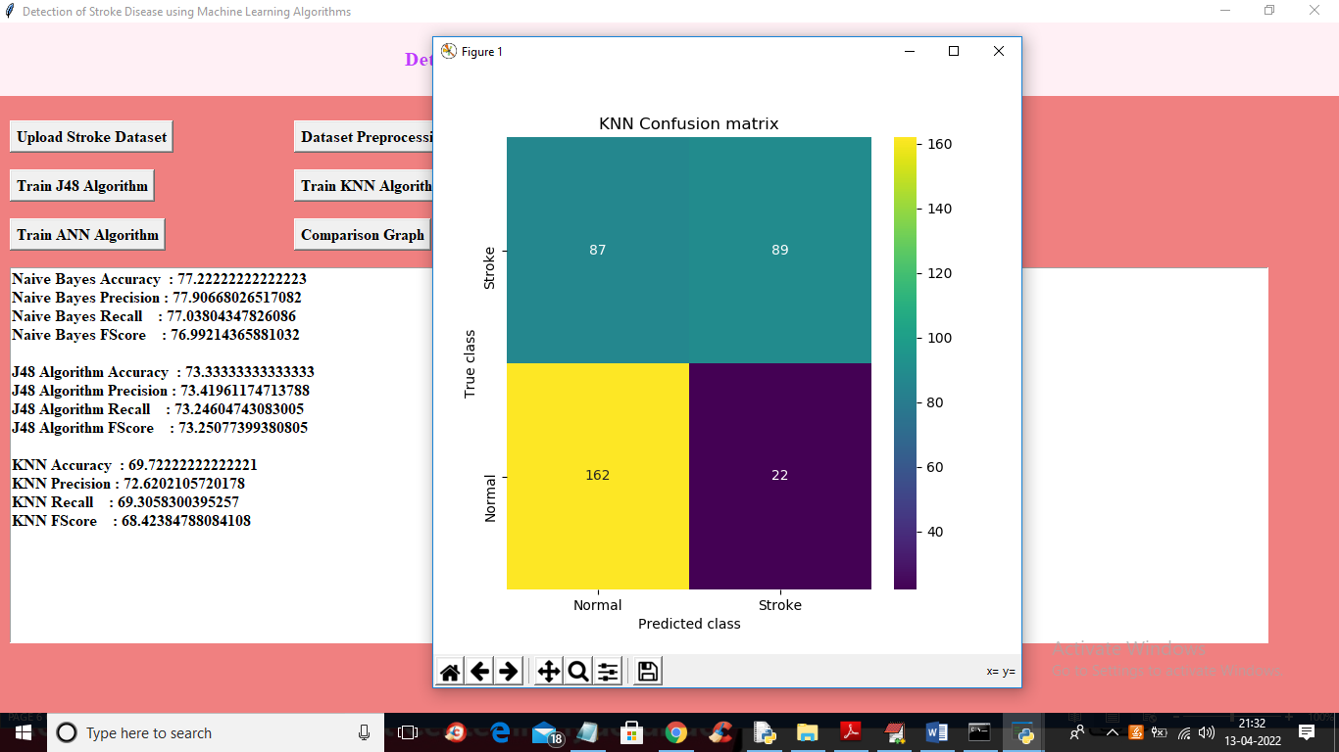
KNN Algorithm

Slide 25
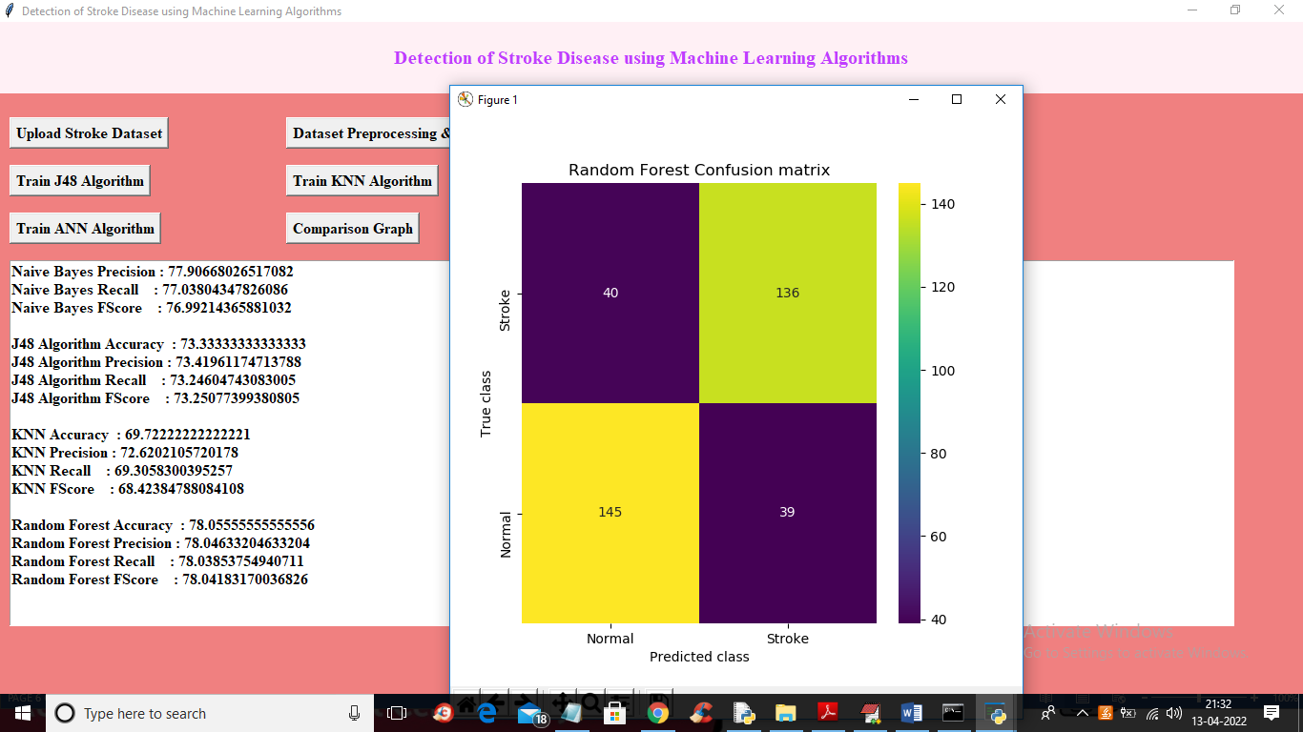
Random Forest Algorithm

Slide 26
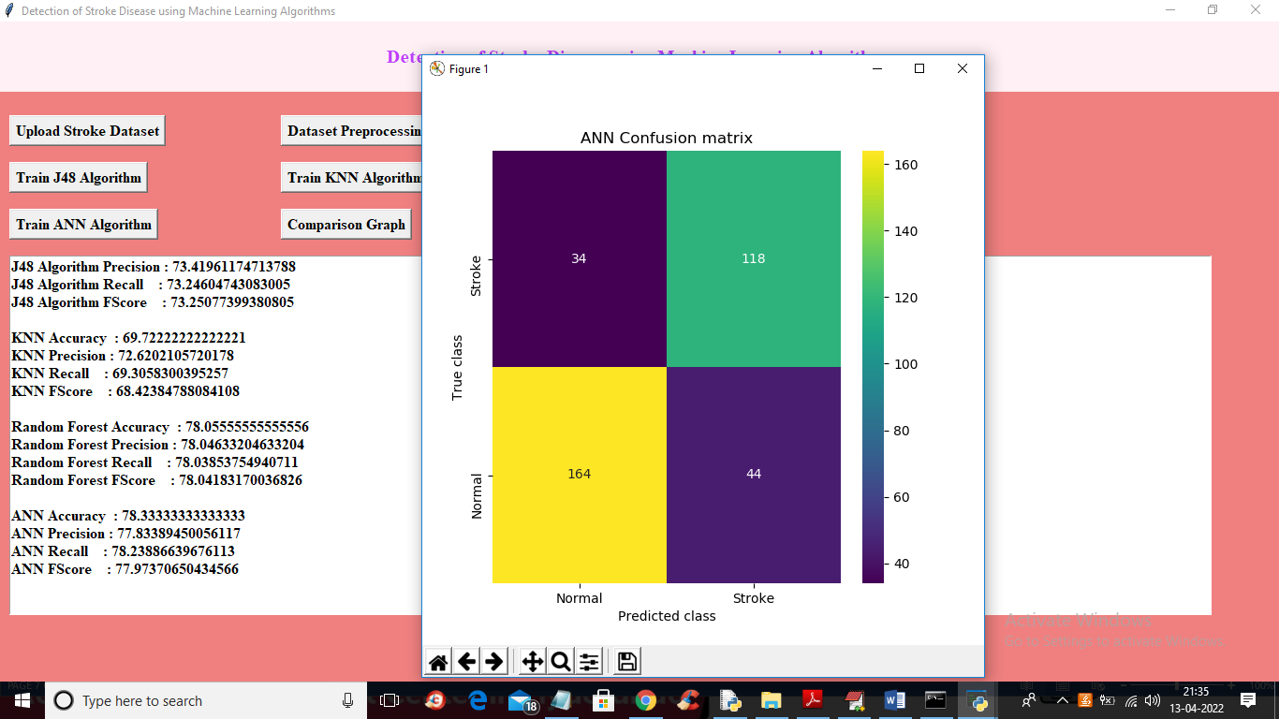
ANN Algorithm

Slide 27
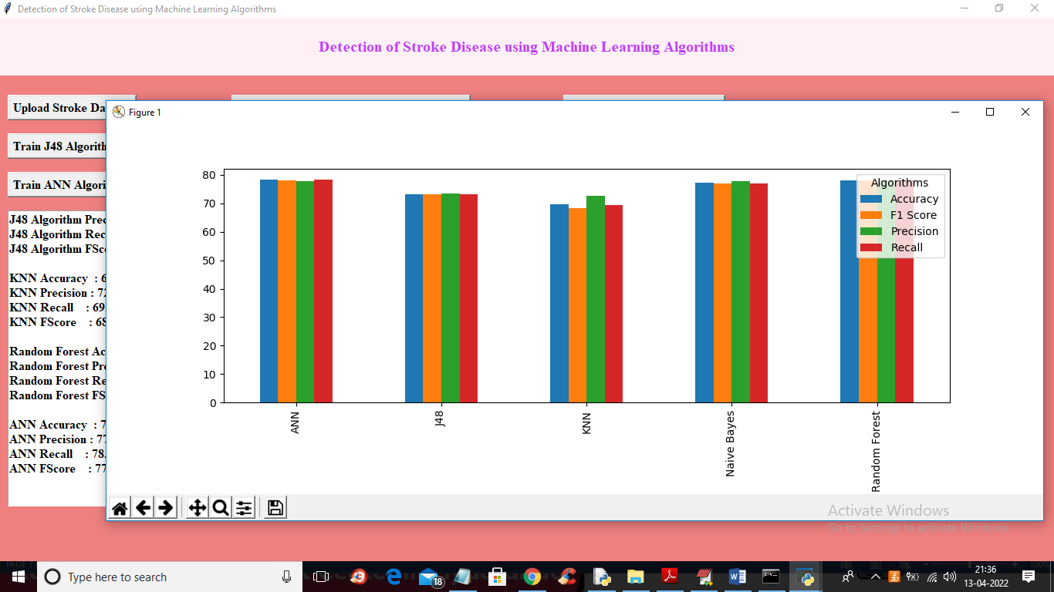
Comparison Graph

Slide 28
Conclusion
Heart disease identification using machine learning (ML) classification in e-healthcare is a powerful approach that can significantly improve early diagnosis and treatment outcomes. By leveraging a variety of patient data such as demographics, medical history, clinical test results, and lifestyle factors machine learning models can be trained to predict the likelihood of heart disease with high accuracy. These predictive models can assist healthcare professionals in making more informed decisions, potentially reducing the risks of heart disease and improving patient outcomes. From the performance analysis, we see that ANN Algorithm performs better than other methods.

Slide 29
Future Enhancement
Future improvements in machine learning for heart disease diagnosis aim to make it more accurate and reliable. New models will explain their predictions clearly so that doctors and patients can trust the results. ML can work with wearable devices to monitor heart health in real time, helping detect problems early. Combining ML with traditional tools can create stronger diagnostic systems. Clear rules and guidelines will also make it easier to develop and use ML in healthcare. These advancements will make heart disease diagnosis faster, smarter, and more accessible to all.

Slide 30


